Slide 1
Using Artificial Intelligence in Orthodontics
By: Whitney McNair

Slide 2
Overview
Motivation
Model/Images
Results
Conclusions
Takeaways from FAMU REU Research Program
Acknowledgements
References

Slide 3
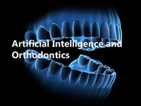
Motivation
My motivation for this project was to show how clever artificial intelligence can be in Orthodontics as well as to become an Orthodontist as my career choice. AI has been used mainly in dentistry to make the process of diagnosis more accurate and efficient, which is of atmost importance in achieving best results to the treatments provided along with superior quality patient care. The developed AI system can provide an objective facial morphological assessment by identifying clinically used facial traits during the orthodontic diagnosis process (e.g., concave profile, upper lip retrusion, presence of scars). This automation considerably reduces the assessment workload for dentists and also prevents variations in diagnosis.

Slide 4
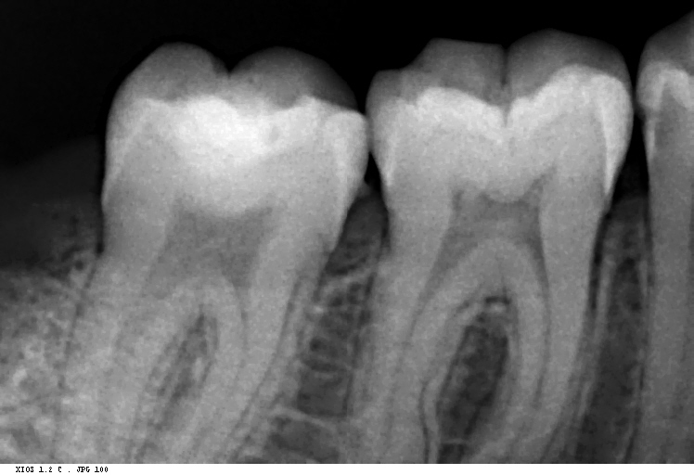
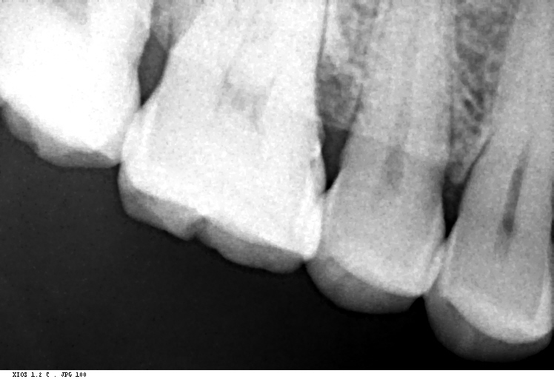
Model/Images
Below we observed an actual dental x-ray dataset. These dental x-rays images below came from Parth Chorkhra on kaggle.com [1]. The images are patient x-rays taken by Parth in his dental imagery data set. In the images we can see the caps and nerves of the teeth. Using these x-rays, we may can also find cavities if there are some. We can also identify other issues with patients teeth by taking and using x-rays.

Slide 5
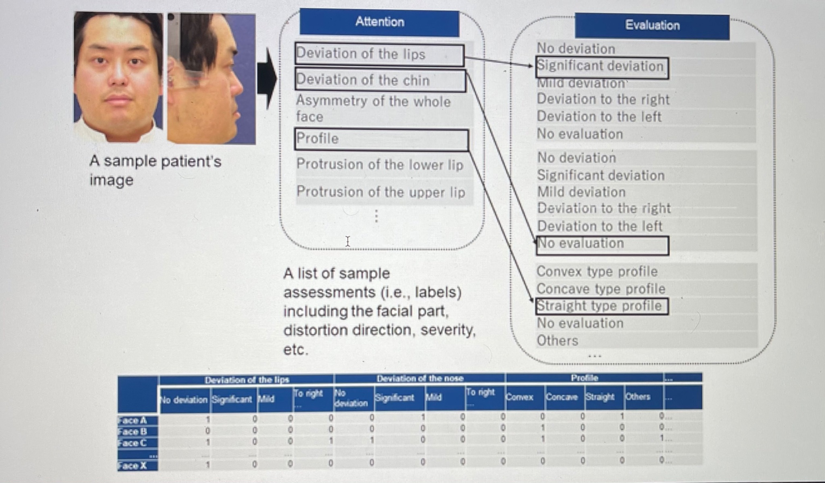
Results
Here is an image to support an algorithm from a researched source below. The detailed implementation can be found in the work in my GitHub. Here is an image of some results of our research that we found using our Google Scholar article. For further information, check out my GitHub report.

Slide 6
Conclusions
Orthodontics may be one of the fastest branches of dentistry to adapt artificial intelligence for three reasons. First, patient encounters during treatment generate many types of data. Second, the standardization in the field of dentistry is low compared to other areas of healthcare. Using AI and large datasets, can now measure the effectiveness of different treatments given with very specific clinical findings and conditions.
Lastly, orthodontics is largely practiced by independent dentists in their own clinics. Despite the promise of AI, the volume of orthodontic research in this field is relatively low. Further, the clinical accuracy of AI must be improved with an increased number and variety of cases. Before AI can take on a more important role in making diagnostic recommendations, the volume and quality of research data will need to increase.

Slide 7
Takeaways from FAMU REU Research Program
What I took away from this wonderful program is how to code, how important Artificial Intelligence is and how to keep up with technology in Data Science. My research skills have improved and I’ve knowledge using different coding engines I haven’t used before. For examples, GitHub, NanoHub, Google Colab and my favorite Visual Studio. Thank you so much FAMU Summer Research Program.
Here is my GitHub report:
https://github.com/cybertraining-dsc/su21-reu-363/edit/main/project/index.md

Slide 8

Acknowledgements
In closing, I want to thank Dr. Carlos Theran, Dr. Yohn Jairo Parra Bautista, Dr. Gregor von Laszewski, and Florida A&M for this wonderful experience. I will never forget it. Thank you.

Slide 9
References
EMBRACING NOVEL TECHNOLOGIES IN DENTISTRY AND ORTHODONTICS. (n.d.). <https://deepblue.lib.umich.edu/bitstream.>
Chokhra, P. (2020, June 29). Medical image dataset. Kaggle. <https://www.kaggle.com/parthplc/medical-image-dataset.>

